Slide 1
FLASH CARD PRESENTATION
Chapter 16 - RECONSTRUCTION

Slide 2
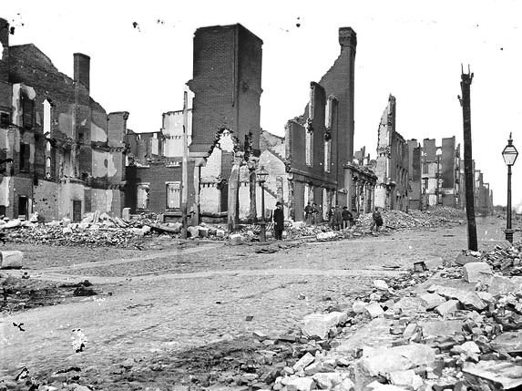
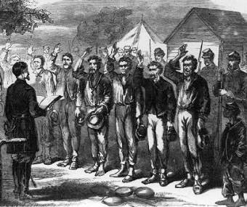
Reconstruction
The period of time between 1865 and 1877 in which Americans worked to bring the North and South together again.

Slide 3
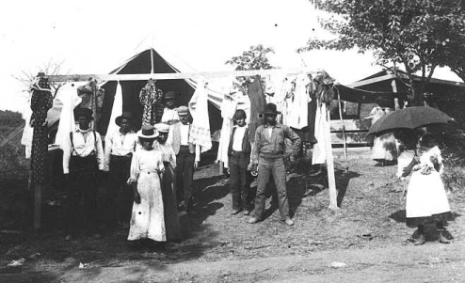
freedmen
Enslaved people who had been freed by the Civil War.

Slide 4
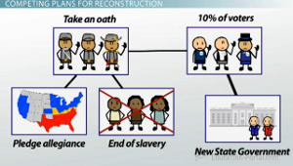
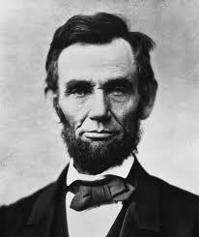
Ten Percent Plan
Abraham Lincoln’s plan for Reconstruction that called for ten percent of voters to take an oath of loyalty to the U.S. and provided amnesty for most Confederates.

Slide 5
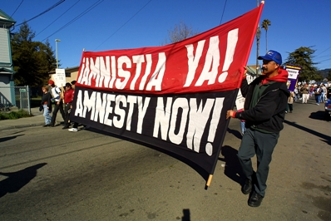
amnesty
A group pardon or forgiveness with no penalty.

Slide 6
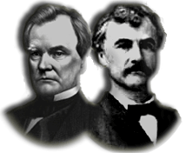
Wade-Davis Bill
Congress’s plan for Reconstruction that called for fifty percent of voters to swear loyalty to the U.S. and anyone that voluntarily fought for the Confederacy would not be able to vote.

Slide 7
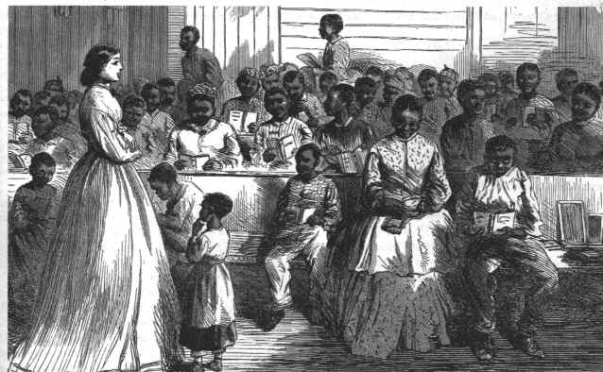
Freedmen’s Bureau
The government agency established by Congress in 1865 to provide emergency relief to those displaced by the war and to provide assistance to former slaves primarily through education.

Slide 8
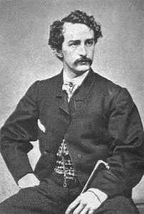
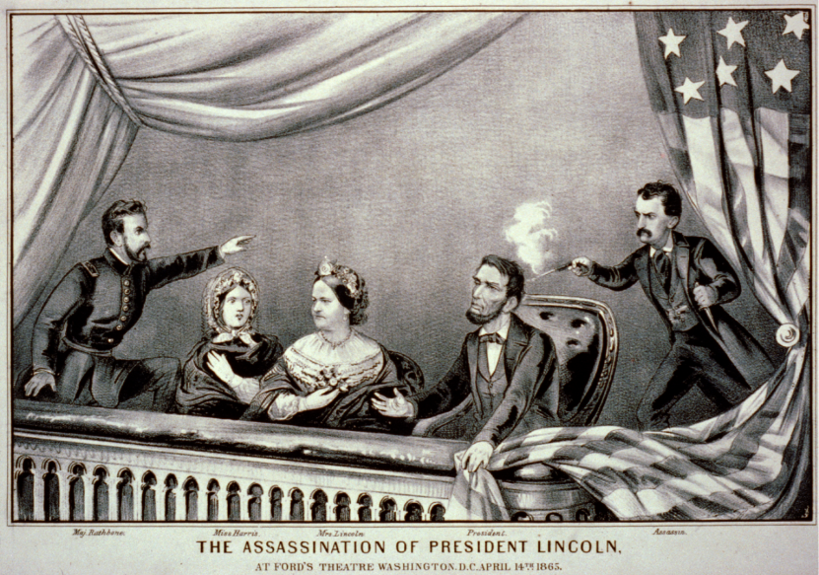
John Wilkes Booth
The man that assassinated President Lincoln on April 14, 1865 – only five days after General Lee had surrendered.

Slide 9
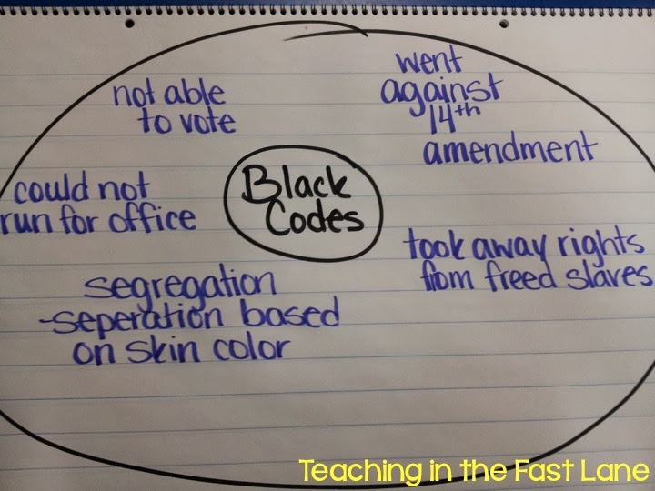
black codes
Laws used by southern states to control African Americans immediately following the Civil War.

Slide 10
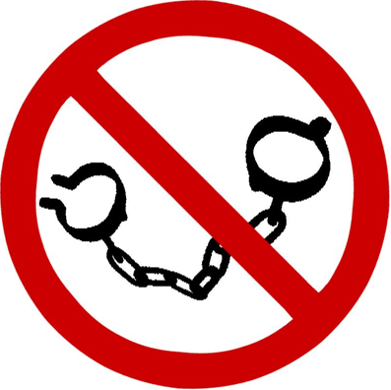
Thirteenth Amendment
The amendment to the Constitution passed in 1865 that abolished slavery throughout the nation.

Slide 11
Fourteenth Amendment
The amendment to the Constitution passed in 1868 that made African-Americans citizens of the U.S. and denied states the power to pass laws that take away a citizen’s rights.

Slide 12
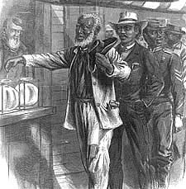
Fifteenth Amendment
The amendment to the Constitution passed in 1869 that granted African American men the right to vote.

Slide 13
Reconstruction Act of 1867
The law that removed the governments of any southern state that refused to ratify the 14th amendment, imposed military rule on those states, and required them to ratify the 14th amendment and let African Americans vote before returning to the Union.

Slide 14
Radical Reconstruction
The period of time between 1867 and 1877 that Congress controlled Reconstruction in the South and African American rights were greatly extended.

Slide 15
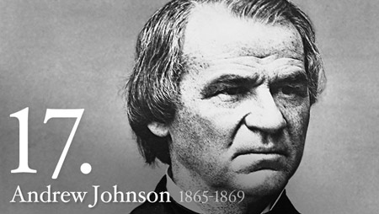
impeach
The bringing of formal charges of wrongdoing against a public official.

Slide 16
scalawags
Southern whites who had opposed secession prior to the Civil War and supported the Republicans during Reconstruction (Traitors to the South)

Slide 17
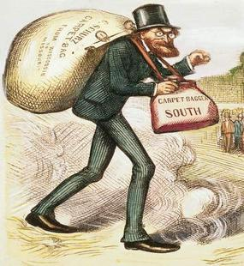
carpetbaggers
A name given by southerners to northern whites who went south to start businesses or pursue political office after the Civil War.

Slide 18
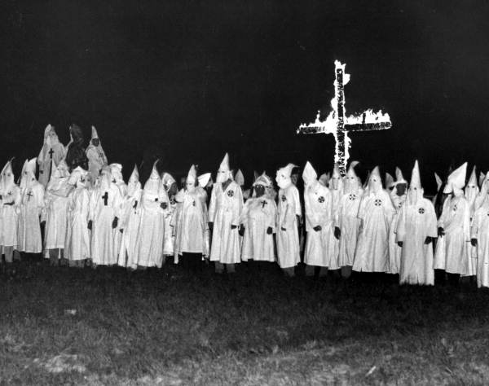
Ku Klux Klan (KKK)
The southern conservative group that used intimidation and violence to keep African Americans from voting and gaining political power.

Slide 19
Election of 1876
The event that led directly to the end of Reconstruction after a “corrupt bargain” was reached allowing Rutherford B. Hayes to become president when he promised to pull federal troops out of the South.

Slide 20
literacy test
The method used by southerners to keep freedmen from voting by giving a test to see if a person could read and write before they could vote.

Slide 21
grandfather clauses
The law created by southerners to allow illiterate white men to vote without taking a literacy test because their father or grandfather had been eligible to vote.

Slide 22
poll tax
The method used by southerners to keep freedmen from voting by imposing a tax or fee on a person in order to vote.

Slide 23
segregation
The enforced separation of races in public places.

Slide 24
Jim Crow Laws
The network of laws created by southern states that prohibited the mixing of races in almost every aspect of life.

Slide 25
sharecropping
The system of labor that replaced slavery in the South after the Civil War. Laborers worked the land for the farmer who owns it, in exchange for a share of the value of the crop.

Slide 26
Plessey v. Fergusson
The Supreme Court case in 1896 that upheld segregation laws. The court said a law could require “separate” facilities, so lo as they were “equal.”

